Slide 1
Summer Storm
Silvia Curbelo

Slide 2
Silvia Curbelo
Born in Matanzas, Cuba, poet Silvia Curbelo emigrated to the United States with her parents as a child.
Her poems couple the personal with the elemental, overlaying collective and individual spaces.

Slide 3
Three view points
The narrator
The woman
The man/customer

Slide 4
Setting
The settings of the appears to be a coffee bar
With a waitress and a customer

Slide 5
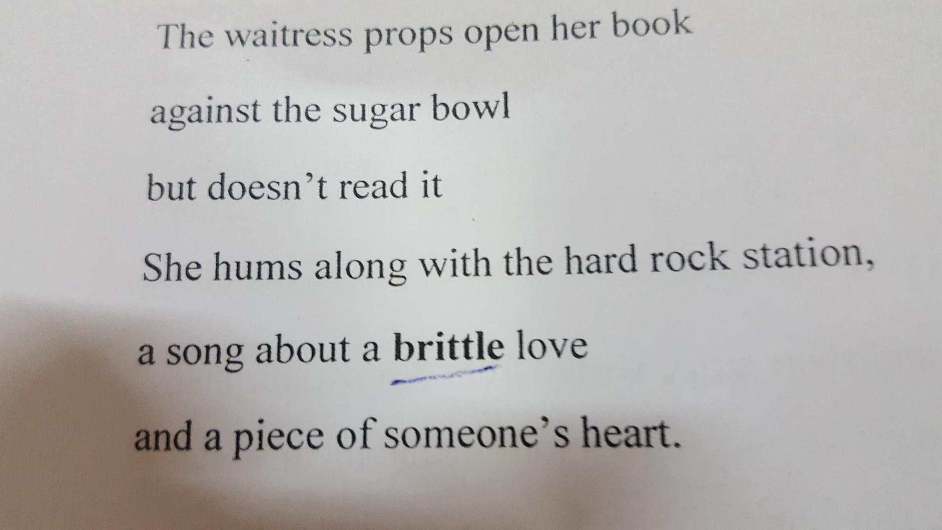

Slide 6
Stanza 1
The waitress props open her book but does not read from it. Her mind is elsewhere, perhaps in a private space of her own.
She hums along with the hard-rock station, The song is about love that is easily breakable, brittle and somebody’s broken heart.
Is the woman reminiscing her broken love affair?

Slide 7
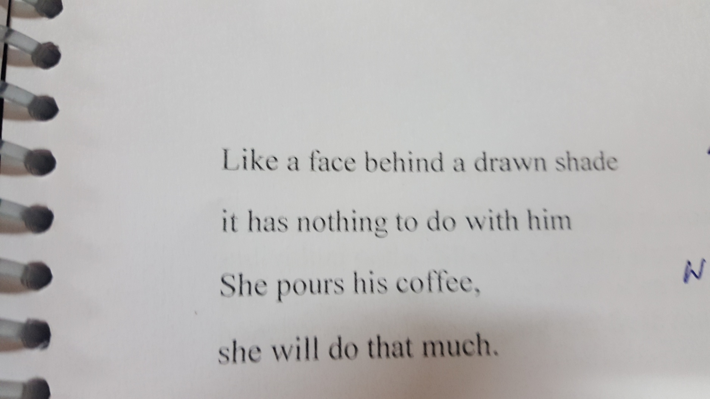

Slide 8
Stanza 2
The customer on his part is in his own world
In this case the her recall has nothing to do with the customer.
For she pours out coffee
That all comes to an end.
She is just doing her job
She is in her own space and the customer in his own.

Slide 9
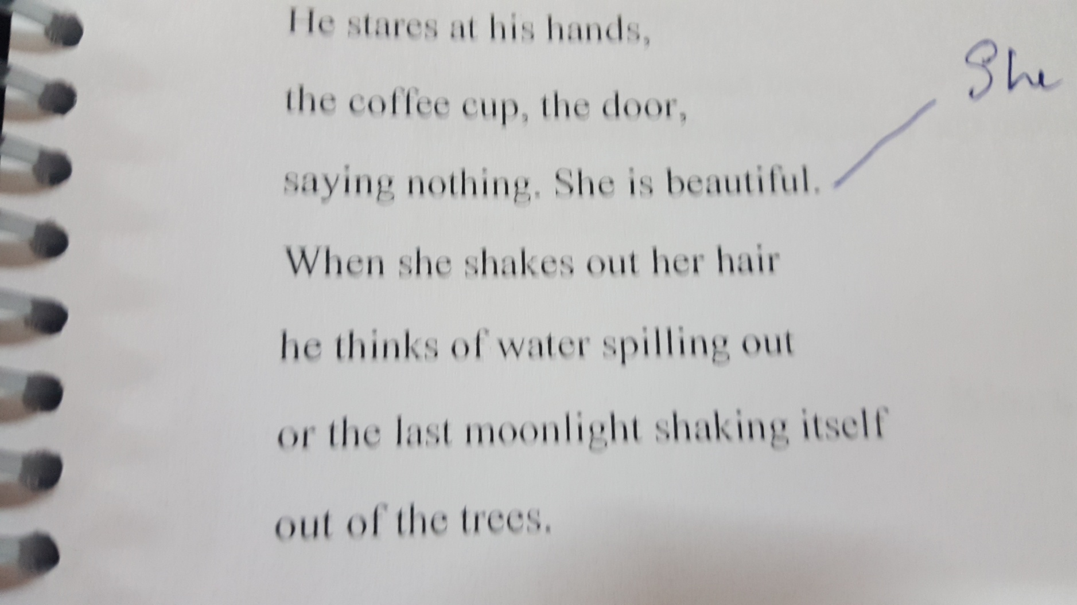

Slide 10
Stanza 3
He looks at his hands, the coffee cup, and the door-all in deep silence.
He observes the waitress, her beauty and the image he conjures up when she shakes her hair. It is a comparison to the nature – water being sprinkled about from her hair and the moonlight disappearing itself behind the trees.

Slide 11
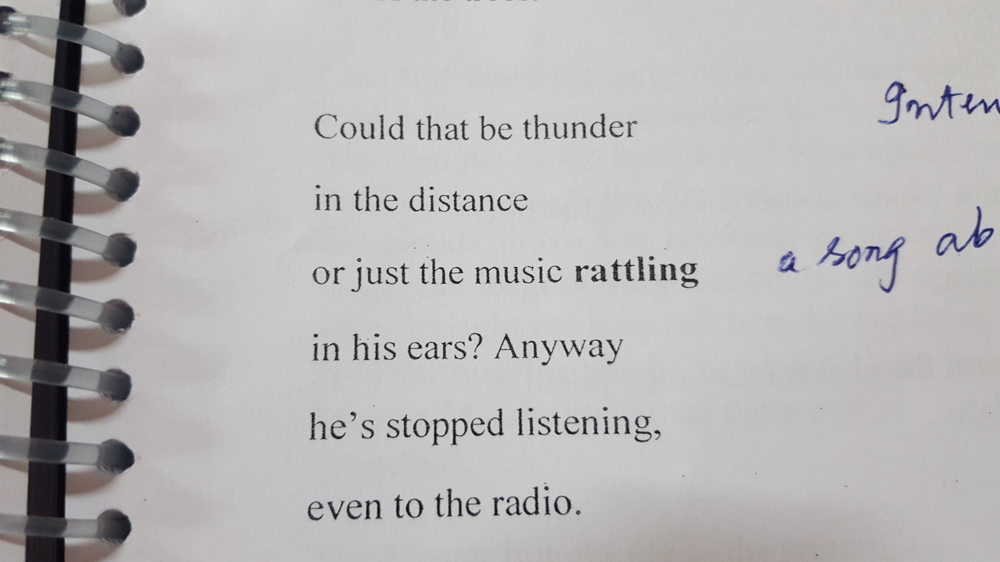

Slide 12
Stanza 4
From now on there seems to be a shift from the personal to the elemental (nature)
We slowly enter into the man’s world.
there are things that are real and things that are imagined-thunder and rattling music.
The man moves into his own space-world of his own.

Slide 13
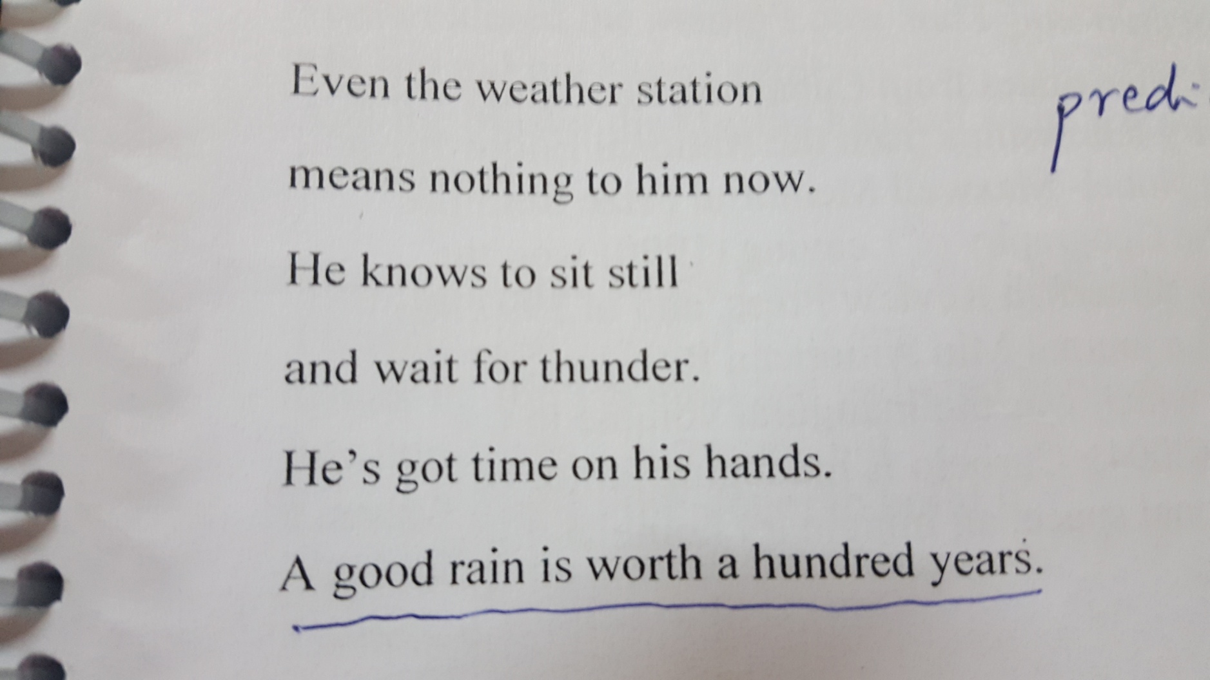

Slide 14
Stanza 5
He is very patient and ready to wait for the rain to follow the thunder.
A good rain in middle of the summer is something to long for.
Rain to be suggestive of regeneration, rebirth and hope.
A storm (accompanied by a rain is a great relief)

Slide 15
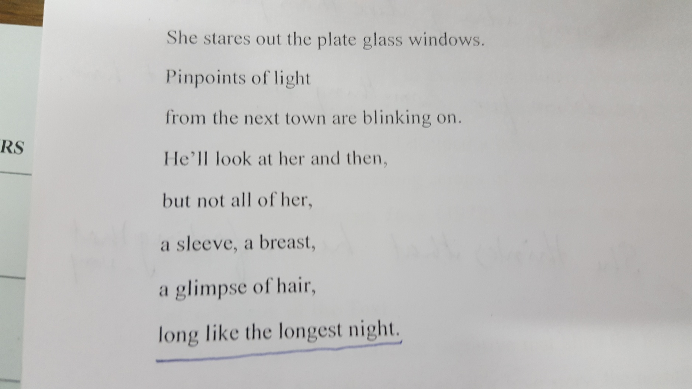

Slide 16
Stanza 6
She stares….blinking on..could be a journey into the past.
An attempt or hidden hope to return to her homeland Cuba.
While she in her own space he too lives in his own world.

Slide 17
Themes
The could also be seen as desire of the human spirit that at times looks for freedom, individuality and identity
Love can have its own manifestations. It could be love for oneself (private space) or it could be for another.
It could be for independence (solitude)

Slide 18
The elements
Elements refer to the nature and the seasons
Summer storm brings in hope and brilliance
Rain could symbolize hope, rebirth, revival and regeneration.
Individual spaces (both mental and physical) matter so much to give meaning to life. Each individual is an island as well as continent

